Slide 1



Enhancing Grocery Sales Strategy with Data
Optimizing Blinkit's sales through comprehensive data analysis and actionable insights

Slide 2

Problem statement
Objectives
Insights
Glimpse of Data
Expected Output
Output
TABLE OF CONTENT

Slide 3

PROBLEM STATEMENT
Blinkit, as India's last-minute grocery app, needs to optimize its sales strategy to stay competitive and increase profitability. The company faces challenges in understanding key performance indicators (KPIs) such as total sales, average sales, and item visibility across various outlets and product categories. There is a need to identify the most and least profitable items, analyze sales trends over time, and understand how factors like outlet size and location affect sales performance. A comprehensive, data-driven solution is required to provide actionable insights for decision-makers.

Slide 4
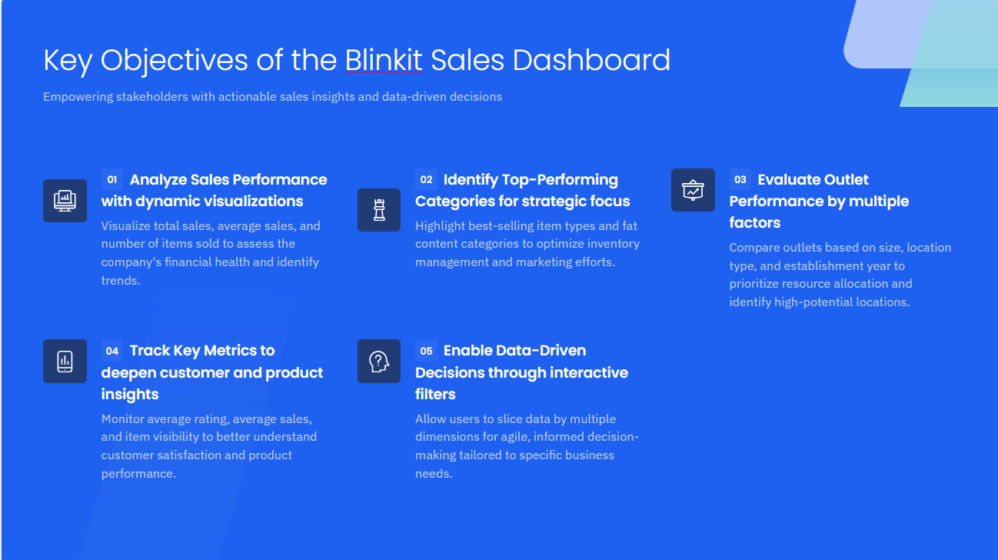

Slide 5
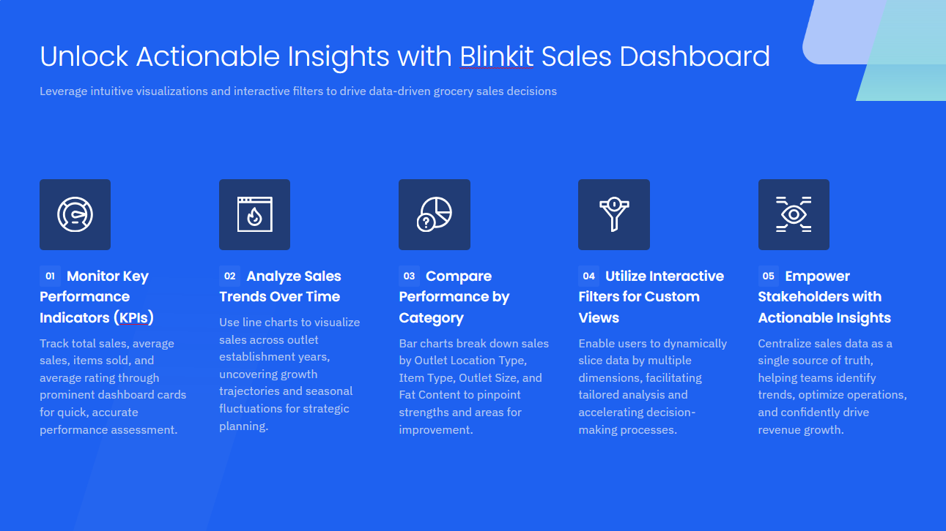

Slide 6

BlinkIT Grocery Data: This table contains detailed information about each item, including:
Item Fat Content
Item Identifier
Item Type
Item Visibility
Item Weight
Outlet Establishment Year
Outlet Identifier
Outlet Location Type
Outlet Size
GLIMPSE OF DATA

Slide 7
EXPECTED OUTPUT
Key Performance Indicators (KPIs): The dashboard will prominently display total sales, average sales, the number of items sold, and average rating using clear, easy-to-read cards.
Sales Trends: A line chart will illustrate sales performance over the outlet establishment years, revealing long-term trends and potential seasonal patterns.
Performance by Category: Bar charts will showcase total sales by Outlet Location Type, Item Type, Outlet Size, and Fat Content, allowing for easy comparison of performance across categories.
Interactive Filters: A filter panel will enable users to slice the data by various dimensions, providing a granular view and catering to specific analysis needs.
Actionable Insights: The final dashboard will serve as a single source of truth for sales data, empowering business stakeholders to identify trends, optimize operations, and drive revenue growth.

Slide 8
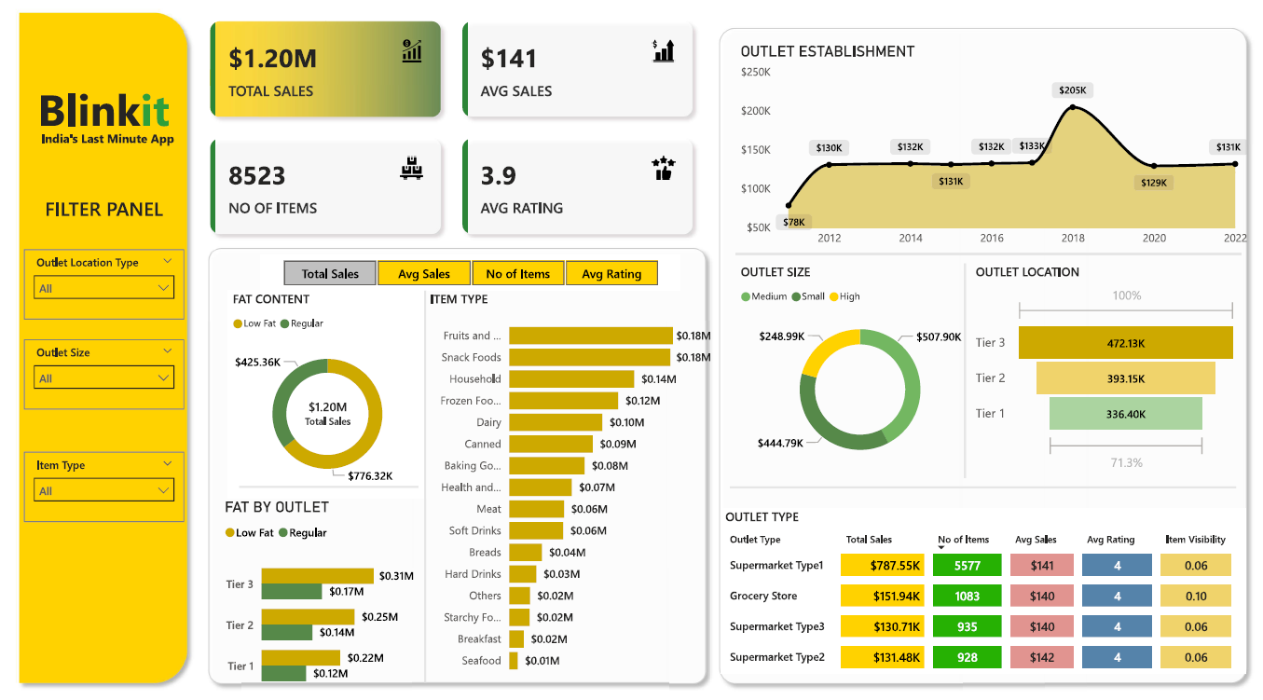
DASHBOARD

Slide 9
THANK YOU

